Slide 1
Double Integrals

Slide 2
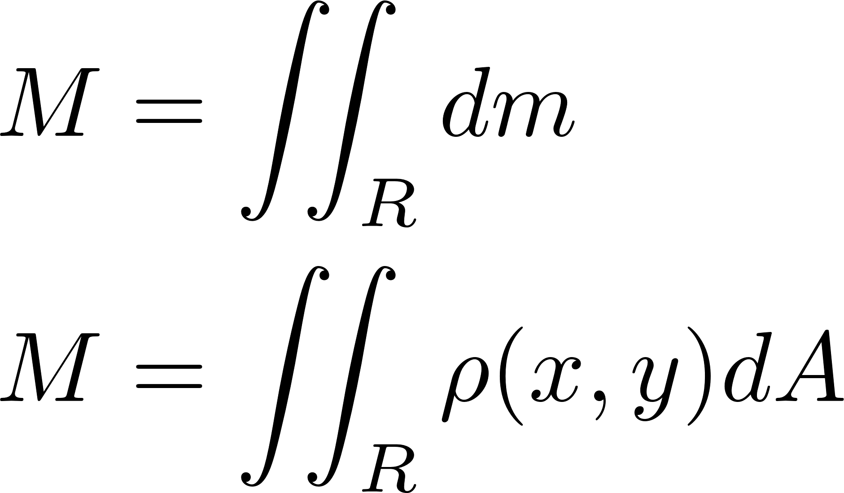
Total Mass
Notes:
A lot of the following calculations done with a double integral are used to describe a lamina (a very thin plate/layer/scale of metal, rock, tissue, etc.). They can be generalized to 3 dimensions using a triple integral, but often the two-dimensional analogs of these shapes have useful properties which can be gleaned.
Total mass = the sum of all the little masses (dm) in a region R. dm = density*dA

Slide 3
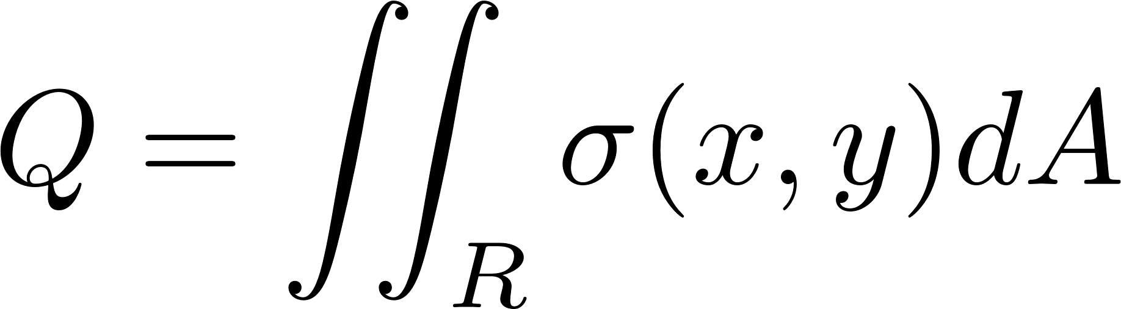
Total Charge
Notes:
Same thing can be done with charge, the sum of the sigma(charge density)*dA = total charge

Slide 4
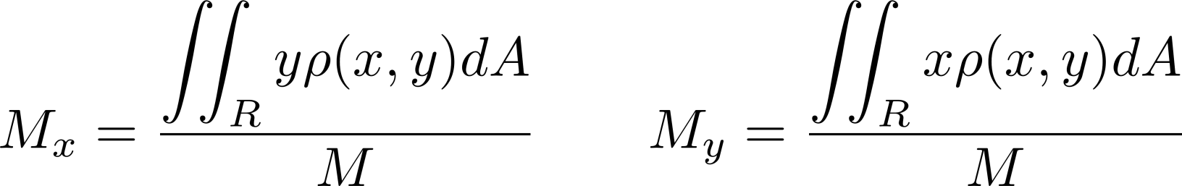
Center of Mass
Notes:
The center of mass from each axis is essentially a weighted averages of mass from that axis. In physics, the center of mass of a body is a good first-order approximation for motion.
Image is of the center of mass of a binary system, where the system’s center of mass does not move.

Slide 5
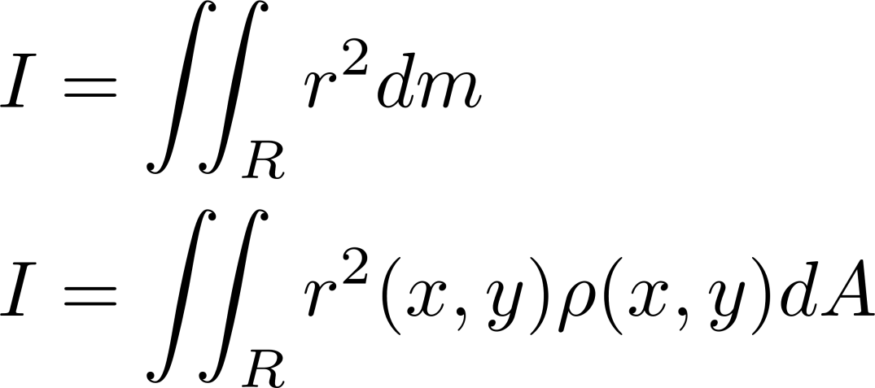

Moment of Inertia
Notes:
Moment of inertia is the rotational analog of mass. Essentially, it describes the resistance to rotational motion, much like inertia.
For a point mass, it’s calculated according to the equation on the left where m is mass, r is distance from the rotational axis. For a very flat (i.e. planar) body, it’s calculated using the integrals on the right. The same substitution from the total mass slide is made.

Slide 6
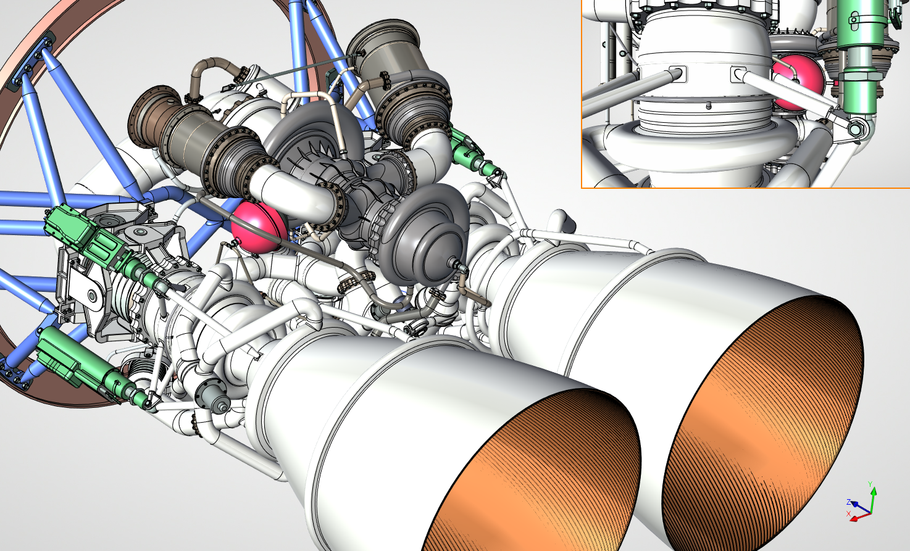
Notes:
While all the things discussed so far are useful calculations for simple systems, in reality, no one performs these calculations in a practical sense anymore. Instead, these calculations are done using software like CAD and other modeling software. However, the algorithms used to perform the calculations still find their basis in principles of integration. For instance, AutoCAD breaks the model into many, many tiny 3D voxels and adds their masses, not unlike a 3D Riemann sum.

Slide 7
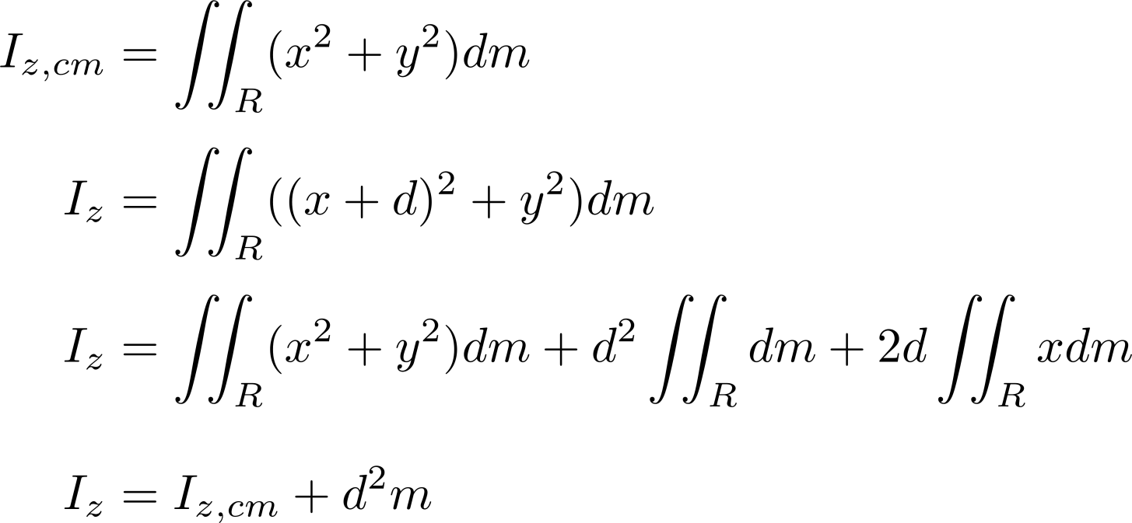
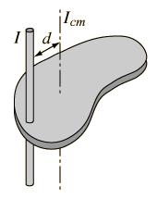
Parallel Axis Theorem
Notes:
The parallel axis theorem is an extremely powerful tool in generalizing and simplifying moment of inertia calculations. It allows one to easily calculate the moment of inertia for any axis given the moment of inertia for the parallel axis through the center of mass. The resulting calculation is far less intensive than recalculating the moment of inertia from the definition. The proof is also quite simple, and results directly from the properties of integrals.
Here, we use the example of shifting the moment of inertia from the axis of rotation parallel to the z-axis. The distance to the z-axis is (x^2 + y^2), so by definition, it’s moment of inertia is the top equation. To shift the moment of inertia, we shift the x-coordinate of the axis by d units, resulting in the second equation. Then, to get to the third equation, we expand and apply some integration properties. The middle term becomes (d^2*m), from the total mass calculation on the first slide, and the last term is the first moment (the numerator of the center of mass equation). Since our axis of rotation goes through the center of mass, by definition, this term must go to zero. Finally, we end up with the bottom equation, which should look quite familiar to everyone currently in physics.
The ability to shift in more than just the x-direction is trivial. Since the axis of rotation already goes through the center of mass, we can just rotate our coordinate system (or our solid body) so that any shift becomes a simple shift in x.
Again, the fact that the parallel axis theorem exist is entirely because the way moment of inertia is defined, and our ability to apply certain integral properties.

Slide 8
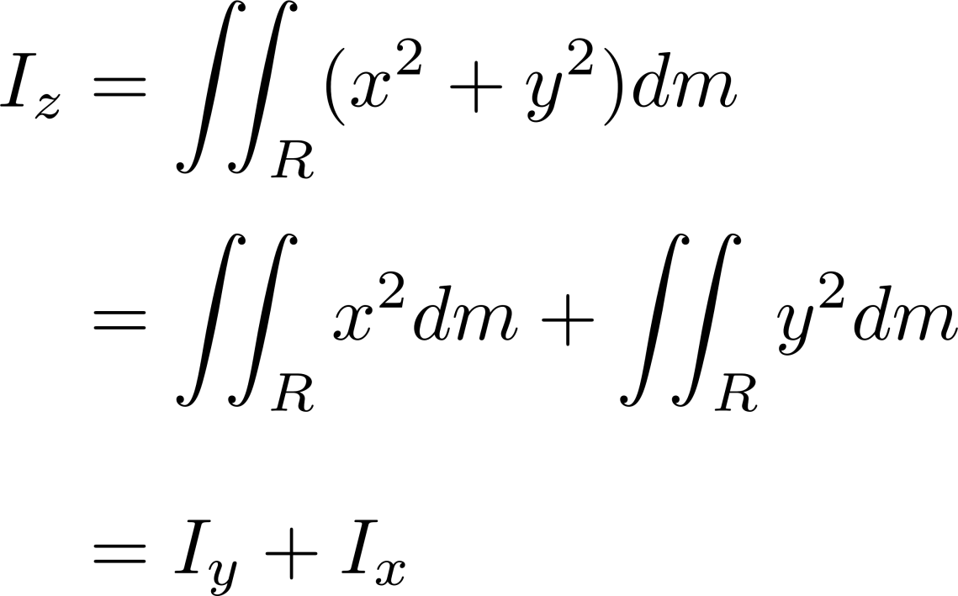
Perpendicular Axis Theorem
Notes:
The perpendicular axis theorem is definitively less well-known (and justifiably so, it’s far less useful) than the parallel axis theorem. It’s proof is simpler than it’s parallel counterpart, though it too stems from applications of select integral properties. Effectively, the perpendicular axis theorem states that the moment of inertia through an axis perpendicular to a plane is the sum of two perpendicular axes within the plane.

Slide 9
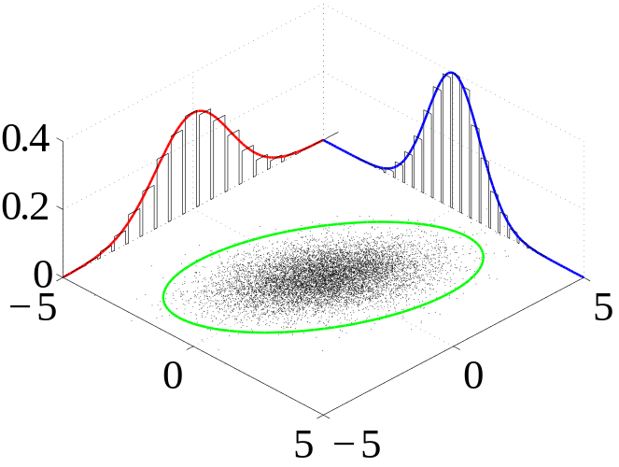
Joint Probability
Notes:
Double integrals are also useful in describing joint probability, the probability that values two random variables both fall within a certain range. The probability with a certain area can be determined using their joint probability distribution and a double integral.

